Slide 1

Snowflake Architecture overview ( Some ) best practices
Josip Saban
Josip.saban@MERIDIAN-DATA.HR

Slide 2
Space: the final frontier. These are the voyages of the starship Enterprise. Its continuing mission: to explore strange new worlds. To seek out new life and new civilizations. To boldly go where no one has gone before!
JEAN-LUC PICARD
starship captain

Slide 3
About me
Finished Computing at Faculty of Electrical Engineering and Computing, Zagreb in 2004, Cotrugli MBA in 2011, now on Executive MBA in Innovation & Entrepreneurship on TU Wien
Started as web developer, then moved to databases and business intelligence with strong focus on management
Owner of Meridian Data, specialized for data analytics and visualization
Details about my career path and partial portfolio are available at:
https://www.linkedin.com/in/josipsaban/
Contacts:
josip.saban@meridian-data.hr

Slide 4
Lecture goals
Introduction to the concept of data warehouse as service
Presentation of Snowflake architecture
Explaining advanced or specific features of Snowflake platform
Lecture assumptions
You come from world of databases…I don’t show trivial things or show you how to code
You know a full business intelligence project lifecycle…I don’t need to explain BI concepts
You came here to learn “what is different” and “why should I try Snowflake”
My goal is achieved if you leave this lecture with feeling “I want to know more”

Slide 5
Agenda
Introduction
Snowflake architecture
Best practices
Selected Snowflake topics
Discussion

Slide 6
Introduction

Slide 7
Organizational topics
This lecture lasts two hours
I will make breaks between blocks
Questions are welcome, I will answer them at the end of each block
If you wish to discuss further, please contact me on mail or LinkedIN, I am in main hotel and have tendency to drink a lot of coffee ☺
It would be great that you have a second monitor during this lecture, so you can make notes or do some interactive activities

Slide 8
Introduction to Snowflake
Snowflake is, currently, only data warehouse built for only for the cloud as SAAS product
It runs on all three main cloud providers - Amazon Web Services, Microsoft Azure, and Google Cloud
It is used to manage structured and unstructured data
It can serve data warehousing, data engineering, and data science use cases
There is no “on-premise” version
It utilizes available compute, transfer and storage cloud options
https://www.snowflake.com/pricing-page-registration-page/

Slide 9
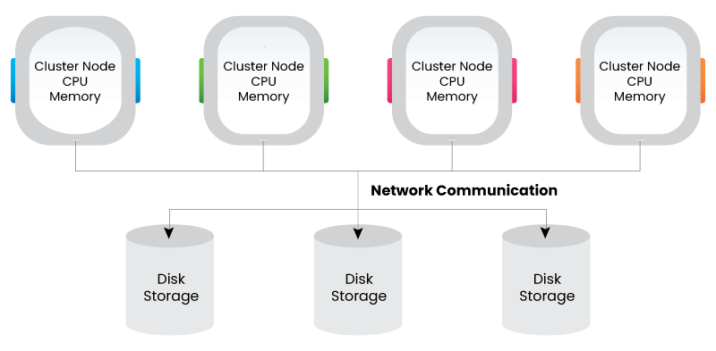
Distributed system architecture
Shared – disk architecture
Each node shares the storage disk but it has its own memory/CPU
Multiple nodes or multiple compute resources like BI dashboards, IDE, ETL workloads…access the single storage disk
System becomes slower as we are onboard more and more ETL workloads - there is a single storage system that is single point of failure.
Benefit - read and write operations are consistent and efficient because it is not having any distributed storage
Disadvantage - distributed locking and two-phase commit since there is common storage shared by all

Slide 10
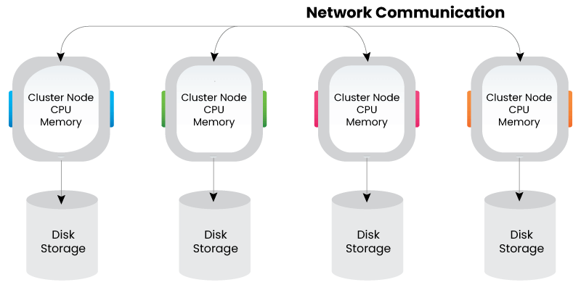
Distributed system architecture
Shared – nothing architecture
No node shares any resource with the other nodes and data is shuffled across all the nodes through the common network connection
Storage and compute are tightly coupled to each other
Adding more and more nodes can scale horizontally, but however, compute and storage cannot scale independently
Disadvantage - data needs to be shuffled across the network, it will be an overhead when there is a lot of data that needs to be shuffled across the nodes – this is how Hadoop, Cloudera Impala or Cassandra work

Slide 11
Distributed system architecture
Shared-Disk vs Shared-Nothing – summary
Shared-Disk | Shared-Nothing
Expensive hardware with redundancy to handle component failure | Typically built on commodity hardware
High availability | Node availability is low and system availability is high
Relatively low scalability | High Scalability
Preferred in OLTP systems that require ACID compliance | Preferred in an environment with high, read/write rates
Data is partitioned and striped but within the storage array | Data may be partitioned and distributed across the cluster

Slide 12
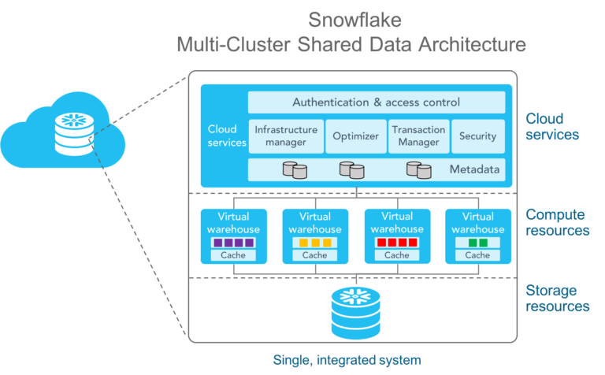
Snowflake architecture - intro
Snowflake's follows the hybrid approach which is called multi cluster shared data architecture
It decouples storage and compute to scale them independently
Snowflake is designed as three-layered architecture, to be discussed in next block where we focus on architecture
Storage resources
Compute resources
Cloud services
All three layers are self-scaling, and Snowflake charges separately for disk and virtual warehouse; services layer is managed inside provisioned computing nodes
Benefit of this design is that each layer may be scaled independently of others

Slide 13
Snowflake architecture

Slide 14
Snowflake architecture
Storage layer
Information is automatically stored in optimized and compressed micro partitions, in columnar fashion
Data is saved in the cloud and is managed using a shared-disk architecture
Components establish connections to the storage layer in order to retrieve information for query processing
Users pay for the monthly average storage usage - storage space is elastic and based on user per TB

Slide 15
Snowflake architecture
Storage layer
Uses scalable cloud blob storage available in all three public clouds
Storage layer supports scaling independent of the compute layer
By splitting compute and storage you can scale read and write requests without having to prioritize one over the other, internally handled by Snowflake - this is one of the unique features
As data loads into Snowflake, algorithms take over to process and partition the incoming data and create metadata
Columnar compression applied to these partitions optimizes the utilization of space as well as improves query performance
The data is also encrypted to meet the highest standards of security required by enterprise companies

Slide 16
Snowflake architecture
Compute layer
Snowflake executes queries using a "Virtual Warehouse“
Layer of separation between the query processing and disc storage layer
Compute executes queries against the data in the storage layer
Virtual Warehouses are computing units consisting of several nodes with Snowflake-provisioned CPU and Memory
Each virtual warehouse may be configured to use a single storage tier
Generally, virtual warehouses operate independently

Slide 17
Snowflake architecture
Compute layer
Uses standard computing infrastructure, i.e. virtual machines available to anyone in a public cloud environment
When an incoming query is detected, computing power becomes available immediately to process the request
As specialty of Snowflake, it deploys multiple virtual warehouses to process a request while simultaneously maintaining the integrity of the transaction, making the system ACID compliant

Slide 18
Snowflake architecture
Cloud layer
This is where all the intelligent action happens - authenticating users, management of the cluster, query execution and optimization, security, encryption, and the orchestration of transaction execution
Examples:
Whenever a login process is initiated, it must traverse this layer
Snowflake queries are routed through this layer's analyzer and later to the Compute Layer for execution
This layer stores the metadata necessary to improve a query or filter data

Slide 19
Snowflake architecture
Cloud layer
This layer runs on compute nodes that are stateless and span the entire data center
Intelligent use of metadata distributed across the cluster of computing nodes maintains the global state of transactions and the system.
Although processing of the metadata takes sizable computing power, by design, the processing of metadata happens on a separate cluster of machines which reduces the impact of the actual compute resources processing the data for the user

Slide 20
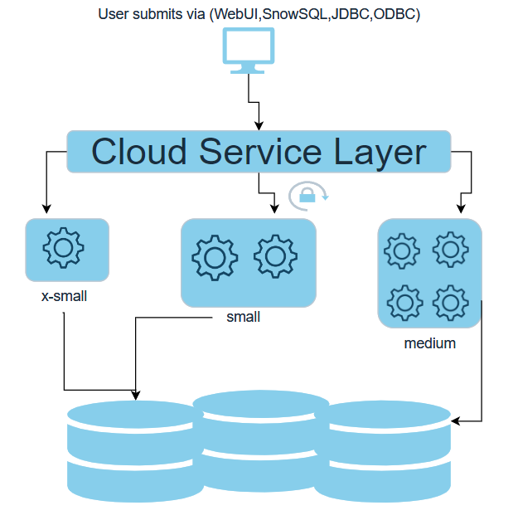
Life cycle of Snowflake query
When a query is issued, the services layer parses the query, compiles it, and determines which set of partitions hold the data of interest and flags them for scanning
User can submit query via any supported client/connector provided by Snowflake
The cloud service layer then scales up/down the warehouse depending on the indication provided by the user (x-small up to x-large)
The cloud service layer first creates a session and checks if the user credential is valid to use the snowflake account using MFA and IP address if applicable.
Once the authentication is done then…
The logical plan of the query gets created
All the objects and operations in the query including the warehouse validated if the respective user has privileges to access the objects
Then the optimized query plan is generated and submitted to the computer layer
It also resumes the cluster if it is shut down or spins up/down the cluster based on the need
Finally, the compute layer reads the data from the storage layer and provides the result to the user
The results will get cached for 24 hours, if we run the same query again then the results will automatically get fetched from the cached data

Slide 21
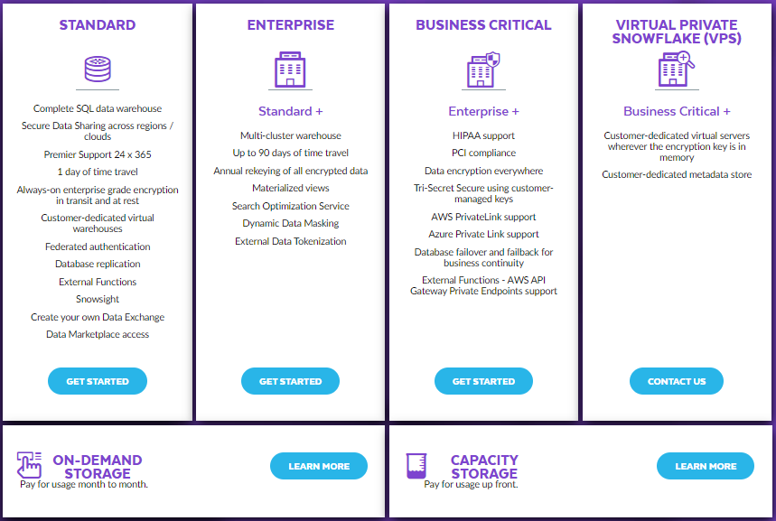
Snowflake versions

Slide 22
Some unique Snowflake features
These are some of unique or specific features of Snowflake
Micro Partitions
Time Travel
Compressed Storage Cost
Data Caching
Data Sharing
Virtual Warehouse
Zero Clone Copy
Micro Partitioning
7 days Fail Safe
Cross-Cloud DB Replication

Slide 23
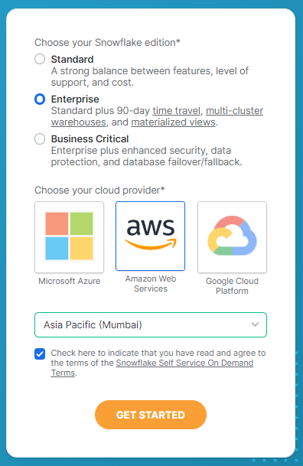
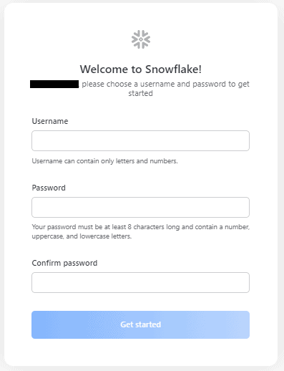
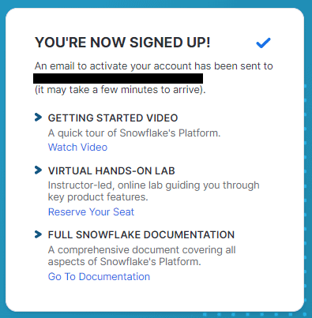
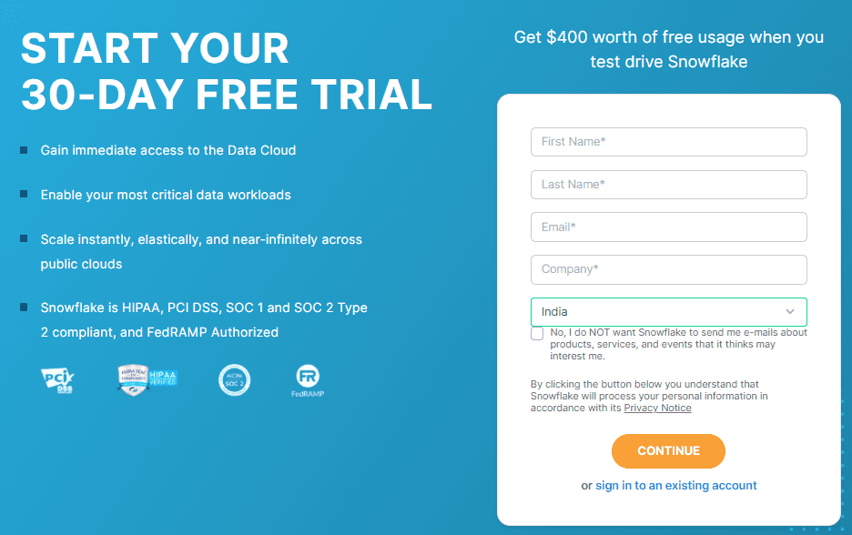
Opening Snowflake test account
Get a one-time email or use a dedicated “spam” e-mail, no payment information required
Follow this step-by-step guide
Go to signup page – https://signup.snowflake.com – and fill-in required information
Select Snowflake Edition ( unless you need to test features from Business-Critical Edition, choose Enterprise Edition )
Choose one of three cloud providers – AWS, Microsoft Azure or Google Cloud Platform (GCP)
Physical location - choose a region close to your physical location; this reduces latency
Go to your email inbox and activate the account - you will find the URL to access your Snowflake account
Choose a Username and Password

Slide 24
Opening Snowflake test account
What do we get with trial account
Trial account includes $400 worth of credits for roughly 40-day period, whichever occurs first
Trial can be started using any Snowflake edition, cloud platform, or region
At the end of the trial, your account will be suspended
You can still log into a suspended account, but you cannot use any features
Once the trial is over, the account can be converted to a paid account by adding credit card details

Slide 25
Best practices

Slide 26
Introduction
High-level data manipulation steps:
Data flows into in DWH through data ingestion tools like Airflow/Prefect, making sure raw data is available.
Data is transformed using SQL and modern data transformation tools like dbt
Data then flows out of it to business users and data visualization platforms
It is imperative that it is done correctly, considering different factors like development and production, security, and business use cases
Focus of this chapter is how to organize your DWH so that as little as possible goes wrong
We cover decisions on your data warehouse solution, databases, schemas and different types of tables

Slide 27
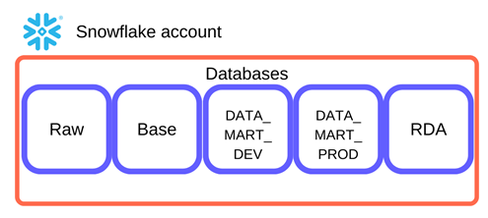
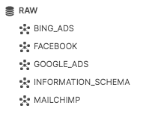
Database organization
Raw data:
It is “highly recommend” to create a Snowflake database to ingest all of raw data
This way you can re-run data models in the case of errors
It is imperative that the only “system” has full access to this is your ingestion tool – Airflow, Airbyte, Prefect, …
Only other “user” that loads this database will be another ingestion tool
No human user can do anything on ingestion, except reading rights
All manual data correction should be, ideally, possible through tasks in ingestion tools, or as one-time user “incident” interventions

Slide 28
Database organization
Transformed data – BASE models
Usually there is a couple of types of transformations
We start with “BASE” models – basic transformations that are done on the raw data
Best practice - avoid having your transformations read from your raw database
They should always read from another Snowflake database that contains them – they are almost same as “RAW” database but with basic transformations such as data type casting and field name changes

Slide 29
Database organization
Transformed data – BASE models
“BASE” data models are usually views rather then tables
This saves costs within your Snowflake warehouse because you aren’t storing a full copy of the underlying data
Because this data is always the same, no matter in development or production, there is no need to create separate environments
Views don’t need to be automated and deployed each day because they simply read from your raw data

Slide 30
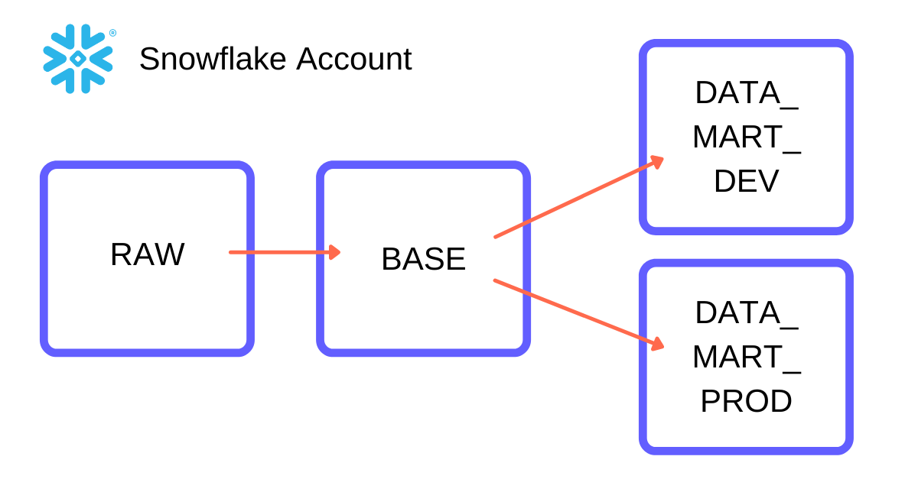
Database organization
Transformed data – DATAMART models
“DATAMART” models are more complex objects that you build with tools like dbt
These require both a development and production environment
You don’t want one database to contain both development and production models, so it is best to create a different database for each

Slide 31
Database organization
Transformed data – DATAMART models
They both read from the tables in the “BASE” database
One is for testing the creation of your data models
Other one is validated, orchestrated, and depends on the business
Tables created in Snowflake using dbt are transient tables - these are similar to permanent tables except they don’t have a full history available on Snowflake
This helps save on storage costs but is another reason why it’s important to always have a copy of all your raw data

Slide 32
Database organization
Transformed data – Reporting and experimentation
Analysts usually write longer one-off queries for reporting and experimentation purposes and they need to be stored so that they can be accessed by business users and visualization tools
Because these are usually only written once and don’t need to be automated to run every day, you do not want to store these in development or production
Most of reporting is done within BI tool, using the data models built in production, rather than within Snowflake
However, if you are automating your reporting in Snowflake, creating these reports in “DATA_MART_PROD” is probably a better idea

Slide 33
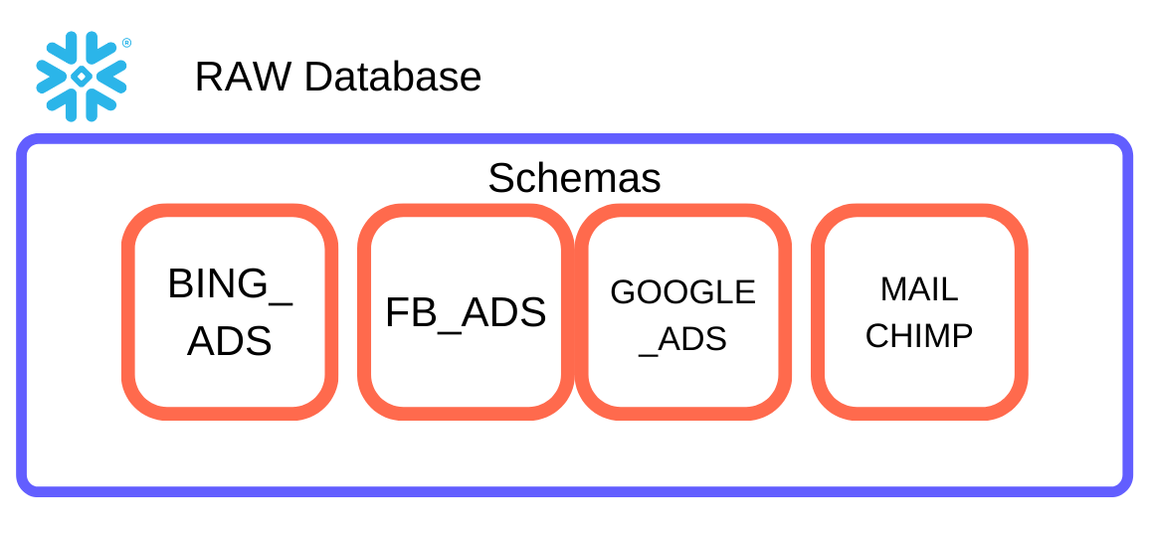
Database organization
Organizing schemas
Snowflake schemas act as a more granular way to organize tables and views within your database
RAW data and BASE models
“RAW” and “BASE” databases should have same schemas
In both of these databases you should create a schema for every data source

Slide 34
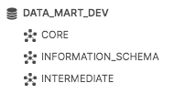
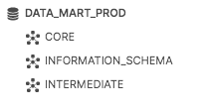
Database organization
Organizing schemas
DEV and PROD models
“DATA_MART_DEV” and “DATA_MART_PROD” should have the same schemas.
Inside these we usually start with two schemas: “INTERMEDIATE” and “CORE”
These terms are commonly used in dbt documentation.
Intermediate models are those that come in between base models and the final product, or the core data model - they are the output tables of the SQL files that don’t necessarily get used for analysis, but are an important step in building the final model
The only person that really needs access to these is the analytics engineer, or the one who coded them.
Core models are those that are the final product of a data model – they are the table that results from the very last SQL file in a sequence of code
These are the ones that data analysts and business users will need to access in your production environment
All analyses, dashboards, and reports will be built from these data models

Slide 35
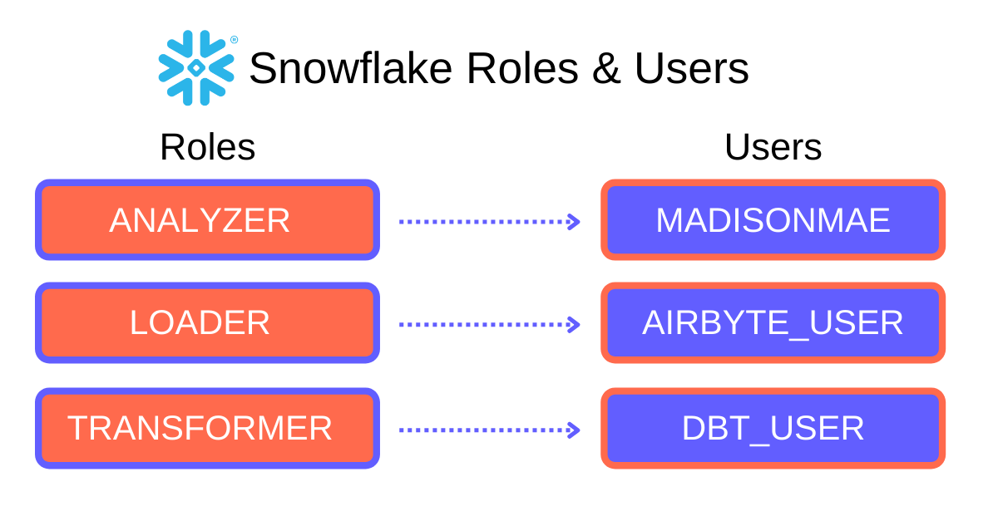
Database organization
Roles and users
Setting up the correct roles and permissions strong keeps data integrity
Not everyone within your organization is going to know how to use Snowflake or properly query the data
When configuring Snowflake environment you should start with creating users, then using the users to determine the Snowflake roles needed for your environment
From there you can create your corresponding warehouse and reset the defaults of each user

Slide 36
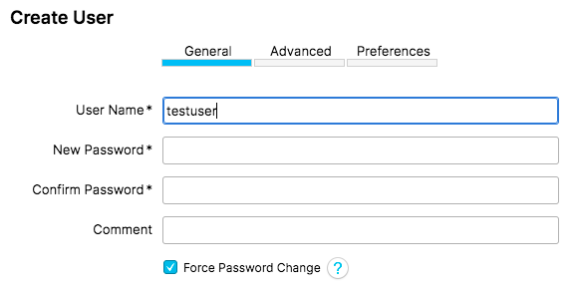
Database organization
Roles and users
Creating users:
Every person and tool that accesses your data warehouse should have its own user
This will keep the reigns tight on who has permission to access certain resources
It will also allow you to track credit usage and changes made.
Also, you may not want everyone in your company to have access to Snowflake
When creating a user, you will have to assign them a temporary password
Make sure you set MUST_CHANGE_PASSWORD=true for security purposes for any human user
When you are creating a user for a tool, you do not want to select this
Make sure you assign it a secure password from the start and store it in a secrets manager

Slide 37
Database organization
Roles and users
Each user should have a default warehouse to help manage costs and usage of your data warehouse
This isn’t necessarily a security feature, but it will help you understand where your Snowflake credits are being utilized
Assign the user the warehouse related to their role
Creating roles
It's a best practice to create a different role for the ingestion tool, analyst, engineer, and business user within your organization
You can also create specific roles for BI tools
Creating a different role for each user and tool will allow you to control what each of these users can and cannot do within each database and its schemas.
Ingestion tool permissions - Access to RAW - Can view, select, and create in RAW
This is the only role that should be allowed to write to your RAW database
Your ingestion tool is the only thing that should be creating schemas and tables within your RAW data location
This is the most important role within your database because of the power it has to access raw data

Slide 38
Database organization
Roles and users
Analytics Engineer permissions:
Access to RAW, BASE, DATA_MART_DEV, DATA_MART_PROD, and RDA
Can view and select from RAW, BASE, and DATA_MART_PROD
Can view, select, and create in DATA_MART_DEV and RDA
The analytics engineer, or whoever is writing the dbt data models, should be the only one who has access to the RAW database
However, they should only be able to view and select from it
Business user permissions:
Access to BASE, DATA_MART_PROD, and RDA
Can view and select from each of these
Business users should have the ability to view data and do basic selections, but not alter the data in any way

Slide 39
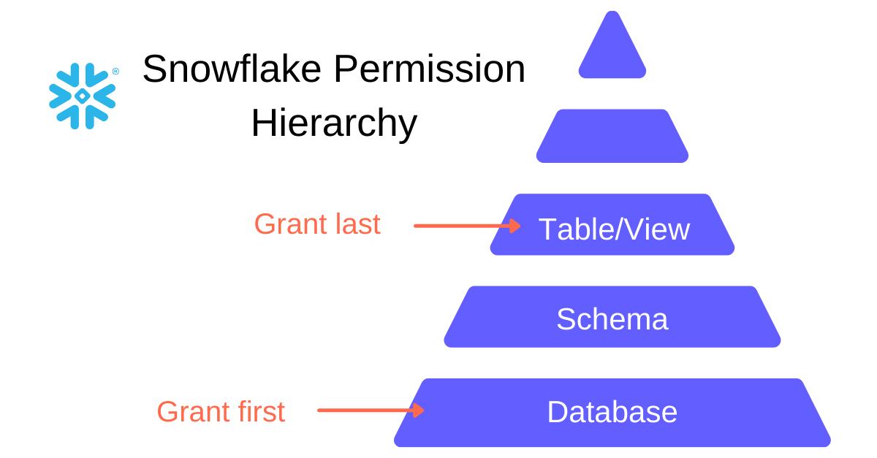
Database organization
Snowflake’s permission hierarchy
You need to grant certain permissions to the database, schema, tables/views, and future tables/views
Snowflake’s permissions are unique in that you can’t assign a permission to the database and expect it to also apply for the schemas and tables/views within that database
Grant permissions to databases
MONITOR allows a role to see details on an object; you will want to grant this to all roles who you want to see the database.
USAGE allows a role to use a database; you will need to grant this to any roles that wish to query the database.
CREATE grants a role the ability to create an object within the database

Slide 40
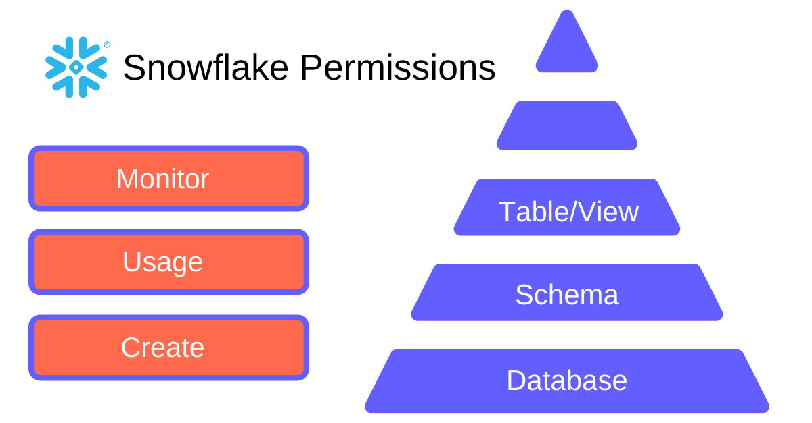
Database organization
Snowflake’s permission hierarchy
Grant permissions to schemas
You need to grant the MONITOR privilege on schemas within your databases to the roles
USAGE allows a role to use a schema; you will need to grant this to any roles that wish to query the schema
CREATE also exists on the schema level - you will need to assign this to all the roles for the schemas within the databases
Grant permissions to tables and views
Here is where things get different - tables and views have unique privileges from databases and schemas.
SELECT allows a role to select from a table or view
INSERT and DELETE are all permissions that should be given to users on “DATA_MART_DEV” and “DATA_MART_PROD”
Since this is the role assigned to the dbt user, it needs to be able to make changes to tables
Keep in mind that these permissions only work for tables, not views.
With tables, views and schemas, you also need to make sure you grant permission to future tables and views within a schema or database

Slide 41
Final thoughts
Start the process of building Snowflake architecture by planning and designing the databases, schemas, and tables/views
Strong documentation of every piece in Snowflake data warehouse architecture is necessary in medium to bigger projects
If you decide something isn’t working for you, don’t be afraid to change it - there are many different ways to organize Snowflake data warehouse architecture

Slide 42
Selected Snowflake features

Slide 43
Lets take a look on Snowflake GUI
Integrated Web GUI is one of the best database web-based administration on the market
Alternative freeware tool – Dbeaver – https://dbeaver.io/

Slide 44
Virtual warehouse overview
Warehouses are required for queries, as well as all DML operations, including loading data
Warehouse is defined by its size, as well as the other properties that can be set to help control and automate warehouse activity
Warehouses can be started and stopped at any time
They can also be resized at any time, even while running, to accommodate the need for more or less compute resources, based on the type of operations being performed by the warehouse

Slide 45
Virtual warehouse overview
Size specifies the amount of compute resources available per cluster in a warehouse
Warehouse Size | Credits / Hour | Credits / Second | Notes
X-Small | 1 | 0.0003 | Default size for warehouses created using CREATE WAREHOUSE.
Small | 2 | 0.0006
Medium | 4 | 0.0011
Large | 8 | 0.0022
X-Large | 16 | 0.0044 | Default for warehouses created in the web interface.
2X-Large | 32 | 0.0089
3X-Large | 64 | 0.0178
4X-Large | 128 | 0.0356
5X-Large | 256 | 0.0711 | Generally available in Amazon Web Services regions, and in preview in US Government and Azure regions.
6X-Large | 512 | 0.1422 | Generally available in Amazon Web Services regions, and in preview in US Government and Azure regions.

Slide 46
Virtual warehouse overview
Impact of size on data loading
Increasing the size of a warehouse does not always improve data loading performance
Data loading performance is influenced more by the number of files being loaded (and the size of each file) than the size of the warehouse
https://docs.snowflake.com/en/user-guide/data-load-considerations.html
Impact of size on query performance
The size of a warehouse can impact the amount of time required to execute queries submitted to the warehouse, particularly for larger, more complex queries
In general, query performance scales with warehouse size because larger warehouses have more compute resources available to process queries
https://docs.snowflake.com/en/user-guide/warehouses-considerations.html

Slide 47
Virtual warehouse overview
Auto-suspension and Auto-resumption
A warehouse can be set to automatically resume or suspend, based on activity
By default, auto-suspend is enabled - Snowflake automatically suspends the warehouse if it is inactive for the specified period of time.
By default, auto-resume is enabled - Snowflake automatically resumes the warehouse when any statement that requires a warehouse is submitted and the warehouse is the current warehouse for the session
This can be used to simplify and automate your monitoring and usage of warehouses
Auto-suspend ensures that you do not leave a warehouse running (and consuming credits) when there are no incoming queries
Auto-resume ensures that the warehouse starts up again as soon as it is needed

Slide 48
Virtual warehouse overview
Query Processing and Concurrency
The number of queries that a warehouse can concurrently process is determined by the size and complexity of each query
As queries are submitted, the warehouse calculates and reserves the compute resources needed to process each query
If the warehouse does not have enough remaining resources to process a query, the query is queued, pending resources that become available as other running queries complete

Slide 49
Data sharing and marketplace
Accessed through GUI
External page – https://www.snowflake.com/en/data-cloud/marketplace/
Please also take a look on two important concepts
Direct share - simplest form of data sharing that enables account-to-account sharing of data
https://docs.snowflake.com/en/user-guide/data-share-providers.html
Data exchange
https://docs.snowflake.com/en/user-guide/data-exchange.html
Take a look on data caching - https://community.snowflake.com/s/article/Caching-in-Snowflake-Data-Warehouse

Slide 50
Secure data sharing
Secure Data Sharing enables sharing selected objects in a database in your account with other Snowflake accounts – you can share:
Tables
External tables
Secure views
Secure materialized views
Secure UDFs
Snowflake enables the sharing of databases through shares, which are created by data providers and “imported” by data consumers
All database objects shared between accounts are read-only

Slide 51
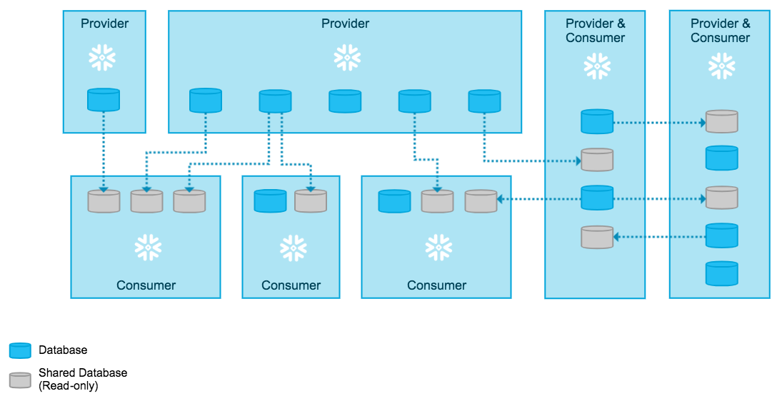
Secure data sharing
All sharing is accomplished through Snowflake’s services layer and metadata store
This means that shared data does not take up any storage in a consumer account and does not contribute to his monthly data storage charges
The only charges to consumers are for the compute resources (i.e. virtual warehouses) used to query the shared data

Slide 52
Secure data sharing
Since no data is copied or exchanged, setup is quick for providers and access to data is instantaneous for consumers:
The provider creates a share of a database in their account and grants access to specific objects in the database
On the consumer side, a read-only database is created from the share
This way you can create a network of providers that can share data with multiple consumers (including within their own organization) and consumers that can access shared data from multiple providers

Slide 53
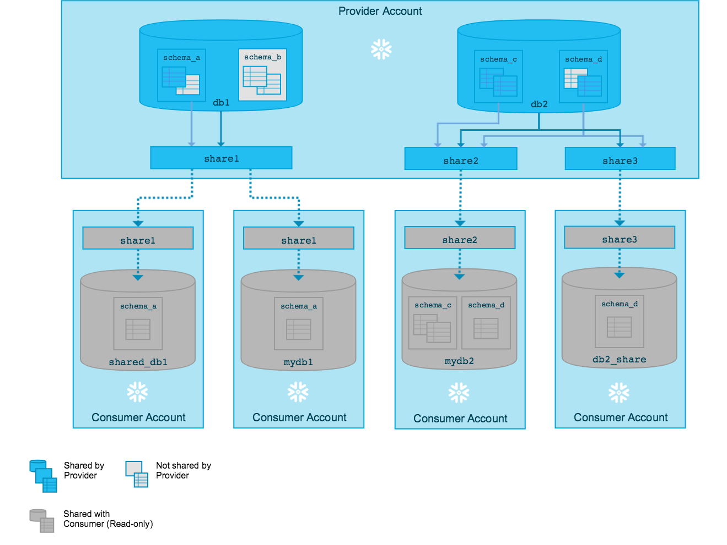
Secure data sharing
Shares
Shares are named Snowflake objects that encapsulate all of the information required to share a database:
The privileges that grant access to the database(s) and the schema containing the objects to share
The privileges that grant access to the specific objects in the database
The consumer accounts with which the database and its objects are shared
Once a database is created (in a consumer account) from a share, all the shared objects are accessible to users in the consumer account:

Slide 54
Secure data sharing
Shares
Usage Metrics Shared with Providers
Consumer’s Snowflake account name
Consumer’s Snowflake organization name
Statistical data on the data consumption, including:
Date of the consumption.
The number of queries a consumer account runs on a provider’s share
The data is provided at the daily aggregate level

Slide 55
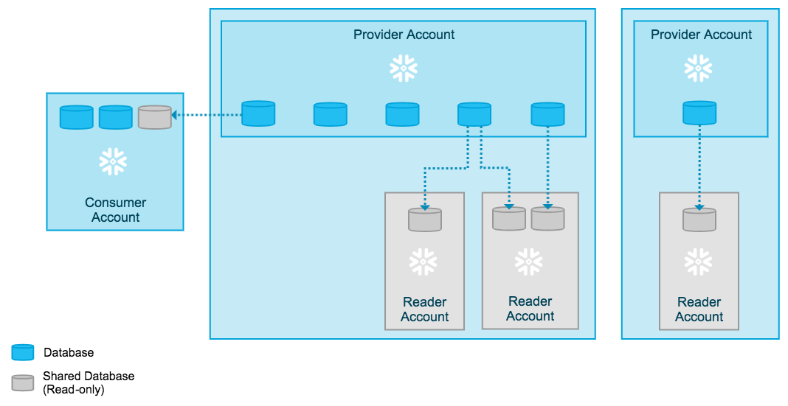
Secure data sharing
Third – party accounts
You might wish to share data with a consumer who does not have a Snowflake account
The provider account uses shares to share databases with reader accounts; however, a reader account can only consume data from the provider account that created it
Users in a reader account can query data that has been shared with it, but cannot perform any of the DML tasks

Slide 56
Monitor costs and operations
Usual business case – “actively monitor Snowflake usage and money spending”
In this case - don’t invent the wheel
Tableau - https://www.tableau.com/blog/monitor-understand-snowflake-account-usage
PowerBI - https://medium.com/analytics-vidhya/snowflake-power-bi-snowflake-usage-report-f628dadbdc85
From these two example you can learn a lot how Snowflake system views are organized

Slide 57
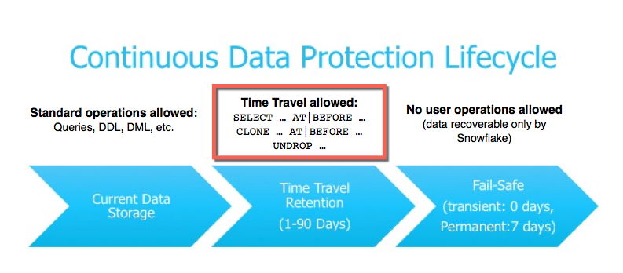
Time travel
Time Travel allows us to access historical data from any point, within a defined period, in the past, until the time travel period
Useful when you…
Updated the wrong data and wanted to roll back 3–4 versions back
Dropped the schema/table/database by mistake
Required historical data for analysis purposes
Time travel is feature of Enterprise Edition
Code examples:
select * from table_name at(statement => 'QueryID')
select * from table_name before(statement => 'QueryID')
select * from table_name at(offset => -60*5)
select * from table_name at(timestamp =>'Mon,26 dec 2020 05:06:23.189-0800':: timestamp_tz)

Slide 58
Time travel
Time travel cannot be disabled for any account
Users with an ACCOUNT ADMIN role can set the data retention period using the period
However, time travel can be disabled for individual objects like databases, schemas, and tables by specifying the DATA_RETENTION_TIME_IN_DAYS parameter to 0 while creating.
Once the retention period is completed, the data will be automatically moved to the FAIL-SAFE layer, and time travel actions can no longer be performed.
If the retention period is defined at the account level, then all the child objects like database, schema, and tables will have the same value until and unless the value is explicitly specified while creating the child objects

Slide 59
Time travel
Storage cost for time travel
We can see the storage cost of time travel with the following query:
SELECT * FROM snowflake.account_usage.table_storage_mterics WHERE schema = schema_name;
From the above query below parameters are important in calculating the cost:
ACTIVE_BYTES — Actual table cost
TIME_TRAVEL_BYTES — Time travel cost
FAIL_SAFE_BYTES — Fail Safe cost

Slide 60
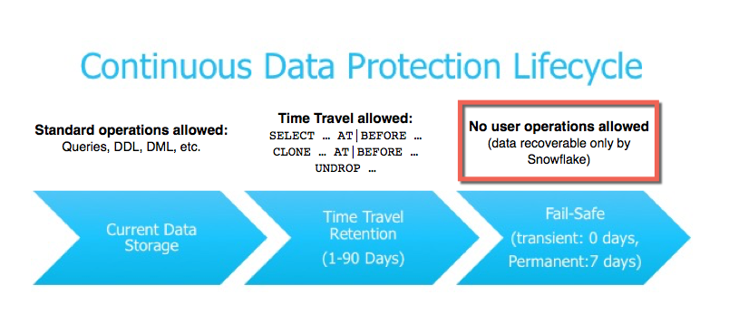
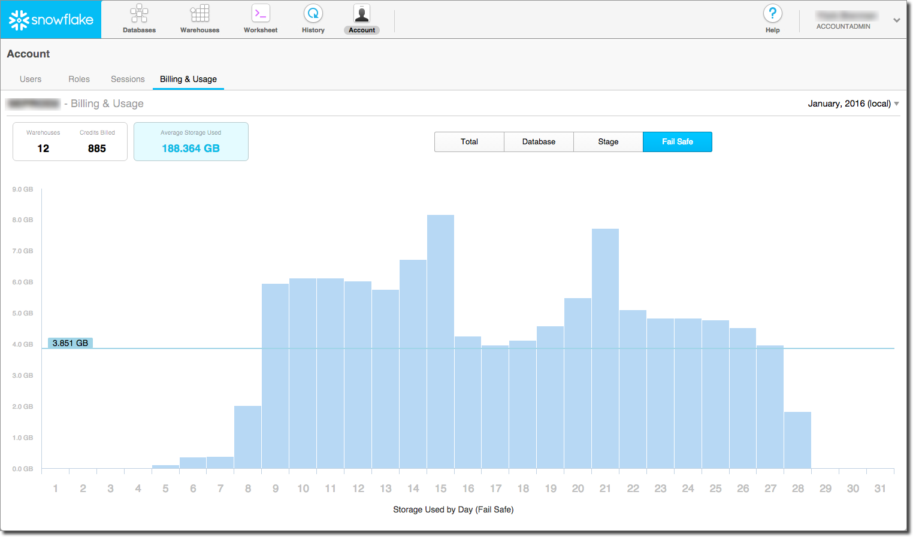
Fail safe – method of last resort
Fail-safe ensures historical data is protected in the event of a system failure or other event
Fail-safe provides a (non-configurable) 7-day period during which historical data may be recoverable by Snowflake - this period starts immediately after the Time Travel retention period ends
This service is BEST EFFORT recovery service
It is intended only for use when all other recovery options failed
Fail-safe is not provided as a means for accessing historical data after the Time Travel retention period has ended
Data recovery through Fail-safe may take from several hours to several days to complete
In the web interface, account administrators can view the total data storage for their account, including historical data in Fail-safe

Slide 61
Micro partitions
Traditional data warehouses rely on static partitioning of large tables for performance and scaling
Static partitioning has a number of limitations, such as maintenance overhead and data skew, which can result in disproportionately-sized partitions
Snowflake Data Platform implements a powerful and unique form of partitioning, called micro-partitioning, that delivers all the advantages of static partitioning without the known limitations
All data in Snowflake tables is automatically divided into micro-partitions, which are contiguous units of storage
Each micro-partition contains between 50 MB and 500 MB of uncompressed data - actual size in Snowflake is smaller because data is always stored compressed
Groups of rows in tables are mapped into individual micro-partitions, organized in a columnar fashion
This size and structure allows for extremely granular pruning of very large tables, which can be comprised of millions, or even hundreds of millions, of micro-partitions
Snowflake stores metadata about all rows stored in a micro-partition, including:
The range of values for each of the columns in the micro-partition.
The number of distinct values.
Additional properties used for both optimization and efficient query processing

Slide 62
Micro partitions
Additional benefits of micro-partitions
Micro-partitions can overlap in their range of values, which, combined with their uniformly small size, helps prevent skew
Columns are stored independently within micro-partitions, often referred to as columnar storage - this enables efficient scanning of individual columns; only the columns referenced by a query are scanned
Columns are also compressed individually within micro-partitions - Snowflake automatically determines the most efficient compression algorithm for the columns in each micro-partition

Slide 63
Micro partitions
Impact of Micro-partitions
DML
All DML operations take advantage of the underlying micro-partition metadata to facilitate table maintenance – some operations, such as deleting all rows from a table, are metadata-only operations
Query Pruning
The micro-partition metadata maintained by Snowflake enables precise pruning of columns in micro-partitions at query run-time, including columns containing semi-structured data
The closer the ratio of scanned micro-partitions and columnar data is to the ratio of actual data selected, the more efficient is the pruning performed on the table.
Not all predicate expressions can be used to pruned - Snowflake does not prune micro-partitions based on a predicate with a subquery, even if the subquery results in a constant

Slide 64
Micro partitions
Data clustering
Typically, data stored in tables is sorted/ordered along natural dimensions (e.g. date and/or geographic regions). This “clustering” is a key factor in queries because table data that is not sorted or is only partially sorted may impact query performance, particularly on very large tables.
In Snowflake, as data is inserted/loaded into a table, clustering metadata is collected and recorded for each micro-partition created during the process.
Snowflake then leverages this clustering information to avoid unnecessary scanning of micro-partitions during querying, significantly accelerating the performance of queries that reference these columns

Slide 65

Thank you for your time

